Slide 1
BCI433 - IBM i Business Computing
User Defined Function

Slide 2
Agenda
RPGLE User defined functions
Lab 8
Review

Slide 3
Lesson Objectives
Upon completion of this lecture and lab 8 you'll be able to:
Create and Use user defined functions in a RPGLE program

Slide 4
The Simple Example
The simple example includes the following source code members:
DAYDSP.dspf
It's display file for the app
DAYFUNCTS.rpgle
The implementation of the function(s) based on the prototype(s)
DAYPROTO.rpgle
Define one or more prototypes of functions
Similar to Java Interface: no implement for the functions
DAYSRPG.rpgle
The RPGLE program that uses/calls the function(s)

Slide 5

Defining PROTOTYPE for a Function
Concept
Abstract methods in Java
Example
DAYPROTO.rpgle
Code:
Function params: DayIn, Packed(1) type
Function return type: Char(9)
Note: don't compile the prototype DAYPROTO.rpgle

Slide 6
Embedding PROTOTYPE in RPGLE
Concept
The process before compiling the RPGLE program
Example
DAYSRPG.rpgle, DAYFUNCTS.rpgle
Code:
//Copy THE PROTOTYPE HERE
/COPY UDFDEMO,DAYPROTO
The slash ('/') in '/COPY' must be at column 7.
‘UDFDEMO' is the UDFDEMO ➔*file.pf-src which holds DAYSRPG.rpgle.
No space(s) before or after the coma '.'.
No ';' at the end of the COPY 'statement'.

Slide 7
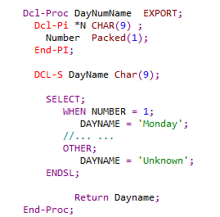
Defining Your Function in RPGLE
DAYFUNCTS.rpgle
//Copy THE PROTOTYPE HERE
/COPY UDFDEMO,DAYPROTO

Slide 8
Invoking Function in RPGLE
DAYSRPG.rpgle
//Copy THE PROTOTYPE HERE
/COPY UDFDEMO,DAYPROTO

Slide 9
DAYFUNCTS2.rpgle
This code uses alternative and improved approach to implement the same function:
The function code will be discussed in class
Note: the code of the CLLE driver program will be also be discussed in class

Slide 10
Homework
Review lecture notes.
Lab8

Slide 11
The End

